Slide 1

G11
Mp3 Player
D
C
B
A

Slide 2
CONTENTS
Topic selection
ON
Design idea
Innovation& Main section
Demonstration
Explain
Summary

Slide 3
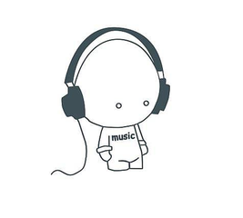
Why we choose to write a Mp3 player?
Program: - everyday-use
- fun
Games? - All-girl group
Shopping application? - Satisfied with Taobao
MP3 Player? - Unanimously passed.
- Cool to use our own MP3 Player.

Slide 4
Divided into two groups: how to play a song, and control the song
Lou Xinyue &Shen Jun: Regular Play and Forward & Backward Play
Ren Xiaonan: Add Functions(like add music, scan file, key part)
Bao Tianyue: Interface Designing
Mp3 player 1.0
Mp3 player 2.0
Mp3 player 3.0

Slide 5
CONTENTS
Topic selection
Design idea
ON
Innovation& Main section
Demonstration
ON
Explain
Summary

Slide 6
Mp3 player NO.1
It’s made by
A
B
Show Time

Slide 7
Functional structure
xxxx
MP3 Player
Regular playing
Backward playing
Forward playing

Slide 8
Finished work
xxxx
MP3 Player
Show Current Position
Regular Play
(Start/Pause/Continue)
Forward&Backward play
✔
✔
✔

Slide 9
Mp3 player NO.2
It’s made by
B
Show Time

Slide 10
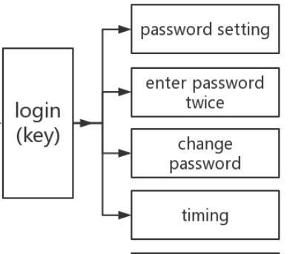
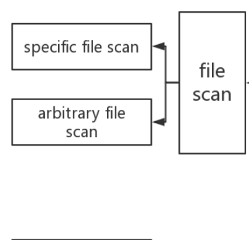

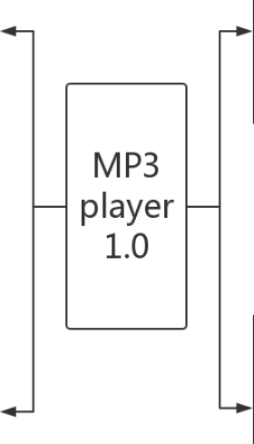
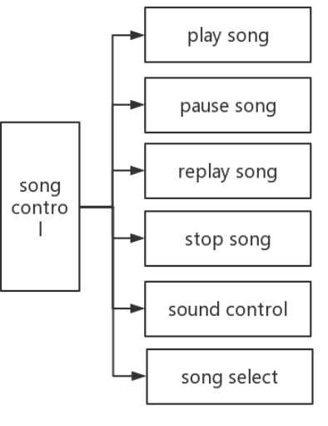
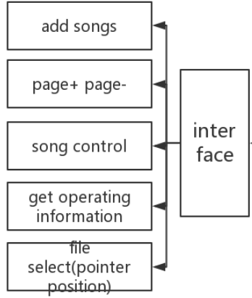
Design ideas

Slide 11
Main section
Key part
Song control
Play song
Pause song
Replay song
Stop song
Volume adjustment
Song+—
Password setting
Second_key
Change_key
timing
For beauty
Set colors
Set console’s
position
Scan a specific file:
Every time you run the program, these songs are displayed in the interface.
Scan a specific file:
In order to add songs.
Song list frame
Page+ Page-
Get operating
information
Switch songs
File scan
Interface

Slide 12

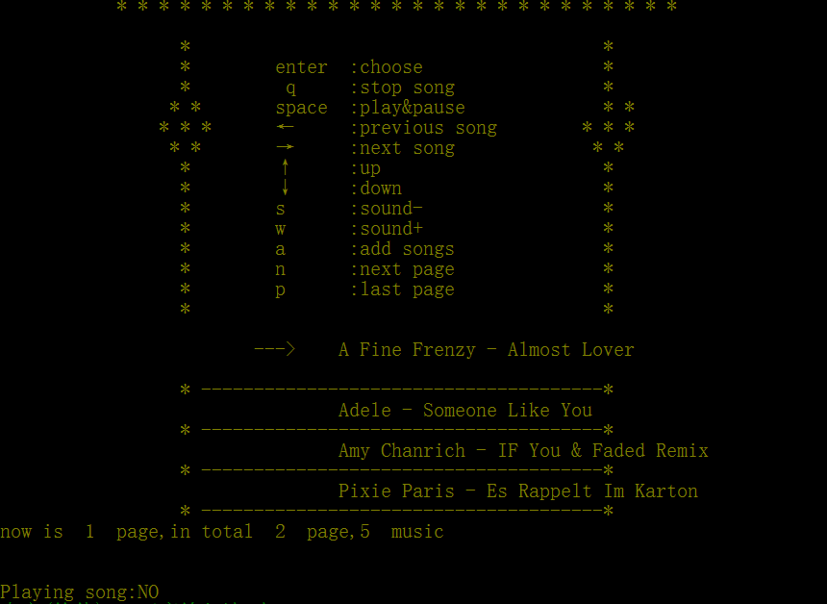
Innovation and improvement
Set colors
Set console position
Adding the key part and timing function
Can add songs and control the songs as the way I like

Slide 13
Mp3 player NO.3
It’s made by
D
Show Time

Slide 14
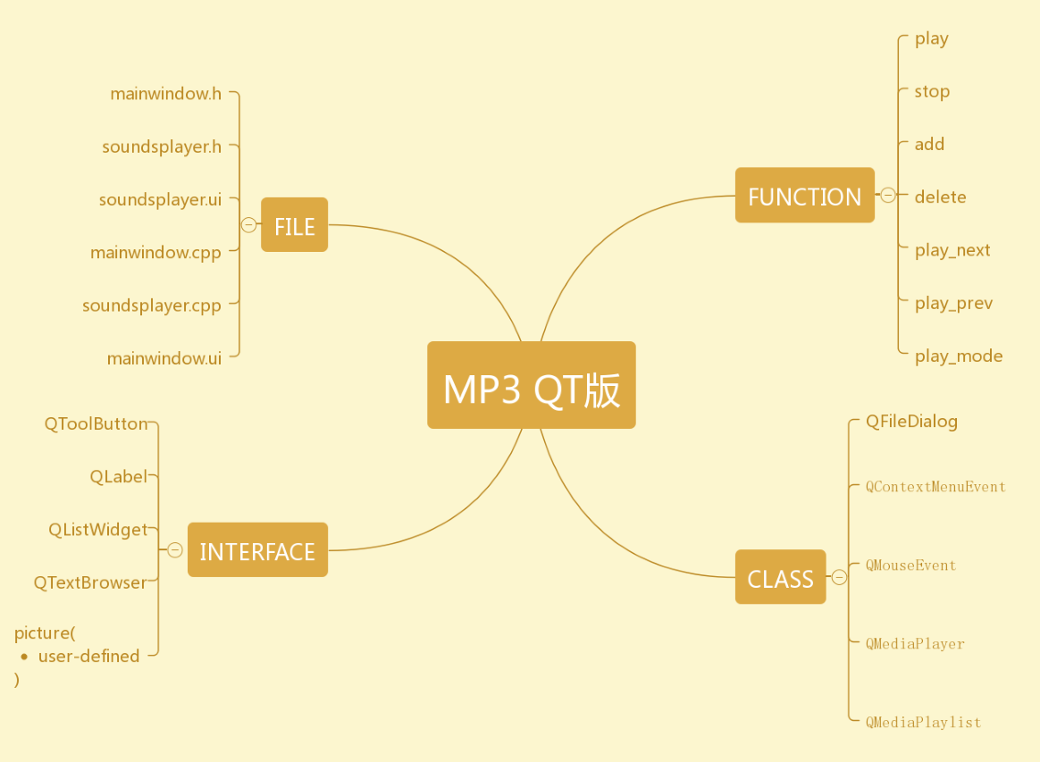
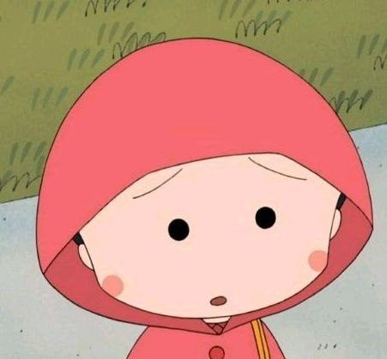
Design ideas

Slide 15
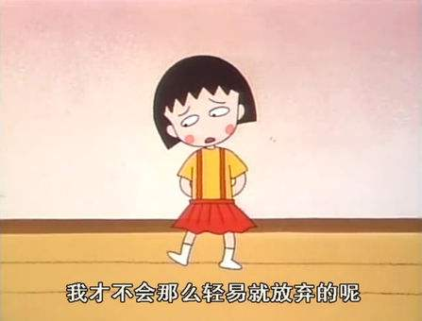
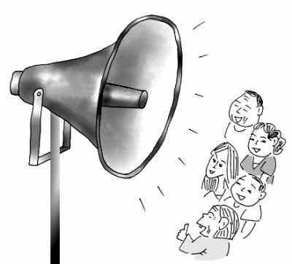
KEY
mainwindow
soundsplayer
pictures
Communication！！！

Slide 16
CONTENTS
Topic selection
Design idea
Innovation& Main section
Demonstration
Explain
Summary
ON

Slide 17
Summary
xxxx
1. We have finished the coding of our MP3 player using what we learned.
2. This program has greatly enhanced our capacity of acquiring information and applying them into practice.
3. It's a real pleasure to listen to music via our own player.

Slide 18
THANK YOU

